Slide 1

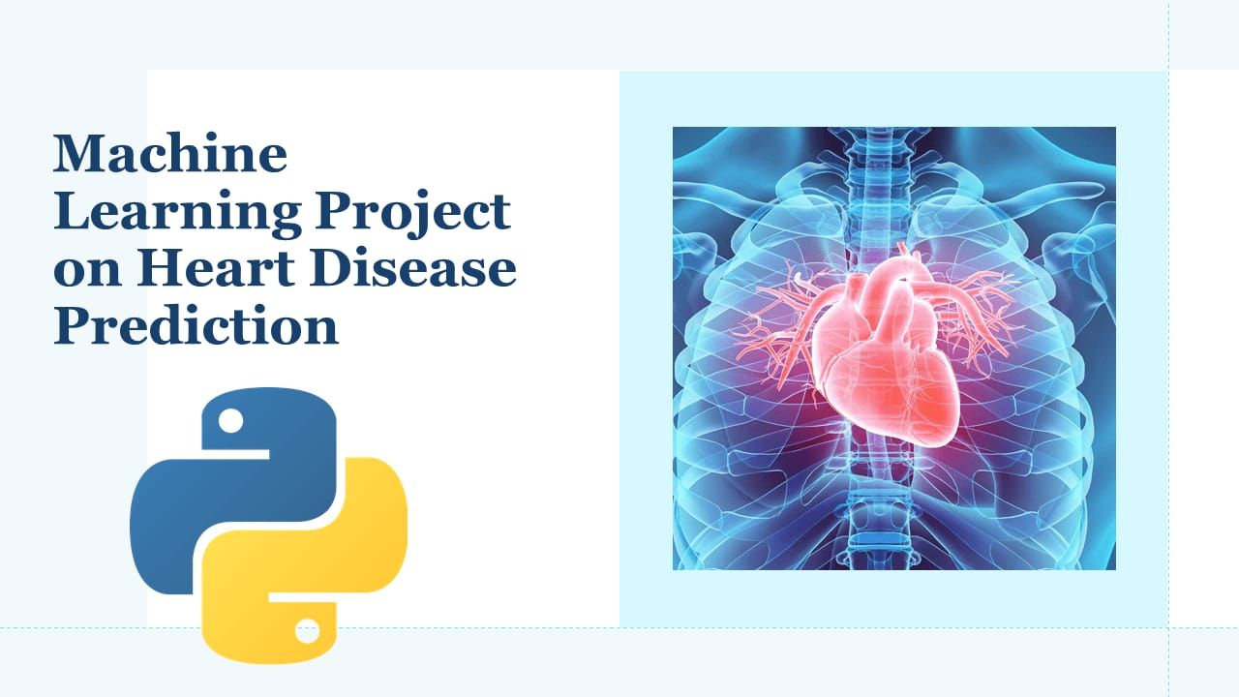
MVR COLLEGE OF ENGINEERING AND TECHNOLOGY
MACHINE LEARNING FOR REAL – TIME HEART DISEASE PREDICTION
GUIDED BY :
PRESENTED BY:
Mr.N.Venkateswara Rao
Devarapalli Rupika - (218H1A4311)
Gollapalli Bharath - (218H1A4317)
Shaik Mohammed Farooq - (218H1A4350)
Kavuri Sai Sreenivas - (218H1A4364)
Chitla Venkat Krishna – (218H1A4309)
​
Submitted for the partial fulfillment
of
Bachelor of Technology
in
Computer Science and Engineering(ARTFICIAL INTELLIGENCE)
COMPUTER SCIENCE AND ENGINEERING (ARTIFICIAL INTELLIGENCE)

Slide 2
CONTENTS
Abstract
Introduction
Existing System
Proposed System
Methodology
Hardware Requirements
Software Requirements
UML Diagrams
Results
Conclusion
Future Scope
References

Slide 3
ABSTRACT
Heart-related anomalies are among the most com- mon causes of death worldwide. Patients
are often asymptomatic until a fatal event happens, and even when they are under observation, trained personnel is needed in order to identify a heart anomaly. In the lastdecades, there has been increasing evidence of how Machine Learning can be leveraged todetect such anomalies, thanks to the availability of Electrocardiograms (ECG) in digitalformat. New developments in technology have allowed to exploit such data to build modelsable to analyze the patterns in the occurrence of heart beats, and spot anomalies from them.
In this work, we propose a novel methodology to extract ECG-related features and predictthe type of ECG recorded in real time (less than 30 milliseconds). Our models leverage acollection of almost 40 thousand ECGs labeled by expert cardiologists across differenthospitals and countries, and are able to detect 7 types of signals: Normal, AF, Tachycardia,Bradycardia, Arrhythmia, Other or Noisy. We exploit the XGBoost algorithm, a leading
machine learning method, to train models achieving out of sample F1 Scores in the range0.93 – 0.99.

Slide 4
INTRODUCTION
Introduction
Heart disease is a leading cause of mortality worldwide, accounting for millions of deaths annually. Early detection and prevention are crucial in reducing the risk of heart disease. Recent advancements in machine learning (ML) have enabled the development of predictive models that can accurately identify individuals at high risk of heart disease.Machine Learning for Heart Disease Prediction
Machine learning algorithms can analyze complex patterns in medical data, including electronic health records, medical imaging, and physiological signals. By leveraging these patterns, ML models can predict the likelihood of heart disease in individuals.
Real-time prediction enables healthcare professionals to intervene promptly, reducing the risk of heart disease. Machine learning models can be integrated into clinical decision support systems, allowing for seamless and efficient prediction.
MACHINE LEARNING FOR REAL – TIME HEART DISEASE PREDICTION

Slide 5
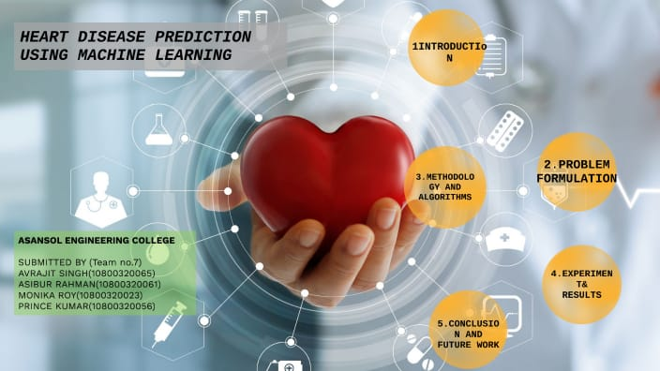
Real-Time Prediction Real-time prediction enables healthcare professionals to intervene promptly, reducing the risk of heart disease. Machine learning models can be integrated into clinical decision support systems, allowing for seamless and efficient prediction.Key Factors in Heart Disease Prediction1. Data quality: Accurate and comprehensive data is essential for training effective ML models.2. Feature selection: Identifying relevant features, such as blood pressure, cholesterol levels, and family history, is critical.3. Model selection: Choosing the most suitable ML algorithm, such as logistic regression, decision trees, or neural networks, is vital.4. Model evaluation: Assessing the performance of ML models using metrics like accuracy, sensitivity, and specificity is necessary.
MACHINE LEARNING FOR REAL – TIME HEART DISEASE PREDICTION

Slide 6
EXISTING SYSTEM
Existing System and Advantages
The existing system for heart disease prediction typically involves manual data collection, rule-based systems, and traditional statistical models, which have limitations in accuracy, data analysis, and real-time prediction. However, some advantages of existing systems include established clinical guidelines, widespread availability, and familiarity among healthcare professionals. Despite these advantages, existing systems often rely on simplistic models, fail to account for complex interactions between risk factors, and require significant manual input, leading to inefficiencies and potential errors. In contrast, the proposed machine learning-based system offers improved accuracy, real-time prediction, and personalized medicine, enabling healthcare professionals to provide more effective and targeted care to patients.
MACHINE LEARNING FOR REAL – TIME HEART DISEASE PREDICTION

Slide 7
ADVANTAGES OF EXISTING SYSTEM
Existing System and Advantages
Existing System
1. Manual data collection
2. Rule-based systems
3. Traditional statistical models
Advantages
1. Established clinical guidelines
2. Widespread availability
3. Familiarity among healthcare professionals
MACHINE LEARNING FOR REAL – TIME HEART DISEASE PREDICTION

Slide 8
PROPOSED SYSTEM
The proposed system utilizes machine learning algorithms to develop a real-time heart disease prediction model. This system collects patient data, including medical history, physical examination results, and laboratory test results, and analyzes it using machine learning techniques. The advantages of this system include improved accuracy, real-time prediction, personalized medicine, efficient data analysis, and early detection. The system provides healthcare professionals with accurate and timely predictions, enabling informed decision-making, reducing workload, and enhancing patient care. Patients benefit from early detection and prevention, personalized care, and improved health outcomes. Overall, the proposed system has the potential to revolutionize heart disease prediction and treatment, leading to better patient outcomes and improved healthcare delivery.
MACHINE LEARNING FOR REAL – TIME HEART DISEASE PREDICTION

Slide 9
ADVANTAGES OF PROPOSED SYSTEM
1. *Improved Accuracy*: Machine learning models can analyze large amounts of data and identify complex patterns, leading to more accurate predictions.
2. *Real-Time Prediction*: The system can provide real-time predictions, enabling healthcare professionals to make timely decisions.
3. *Personalized Medicine*: The system can be tailored to individual patients, taking into account their unique characteristics and medical history.
MACHINE LEARNING FOR REAL – TIME HEART DISEASE PREDICTION

Slide 10
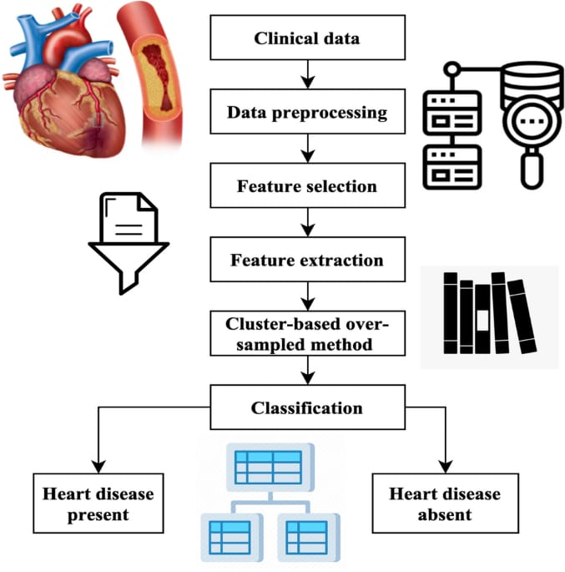
METHODOLOGY

Slide 11
HARDWARE REQUIREMENTS
System : MINIMUM I3
Hard Disk : 40 GB.
Monitor : 14’ Color Monitor.
Mouse : Optical Mouse.
Ram : 4 GB.
MACHINE LEARNING FOR REAL – TIME HEART DISEASE PREDICTION

Slide 12
SOFTWARE REQUIREMENTS
Operating system : Windows 8
Coding Language : PYTHON 3.7
Front end : HTML,CSS
Back end : Python
MACHINE LEARNING FOR REAL TIME HEART DISEASE PREDICTION

Slide 13
UML DIAGRAMS
UML stands for Unified Modeling Language. UML is a standardized general-purpose modeling language in the field of object-oriented software engineering. The standard is managed, and was created by, the Object Management Group
MACHINE LEARNING FOR REAL – TIME HEART DISEASE PREDICTION

Slide 14
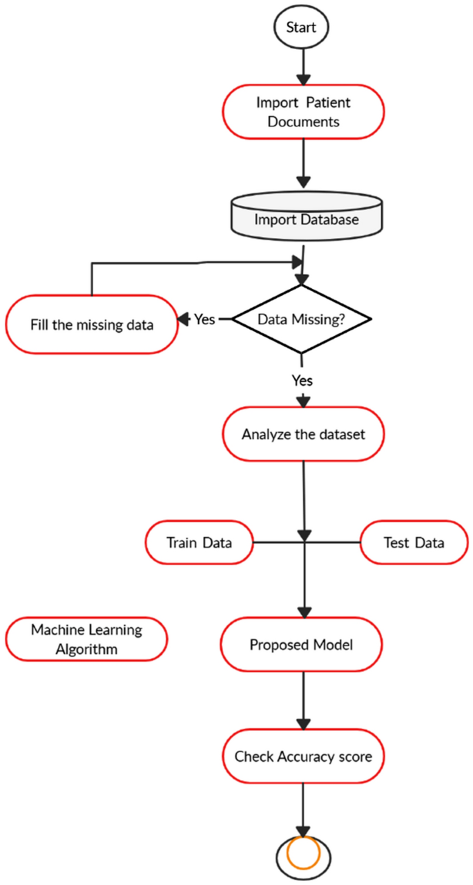
FLOWCHART : USER
MACHINE LEARNING FOR REAL – TIME HEART DISEASE PREDICTION

Slide 15
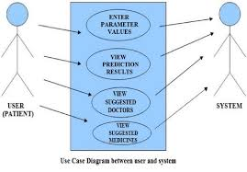
FLOWCHART : ADMIN
MACHINE LEARNING FOR REAL – TIME HEART DISEASE PREDICTION

Slide 16
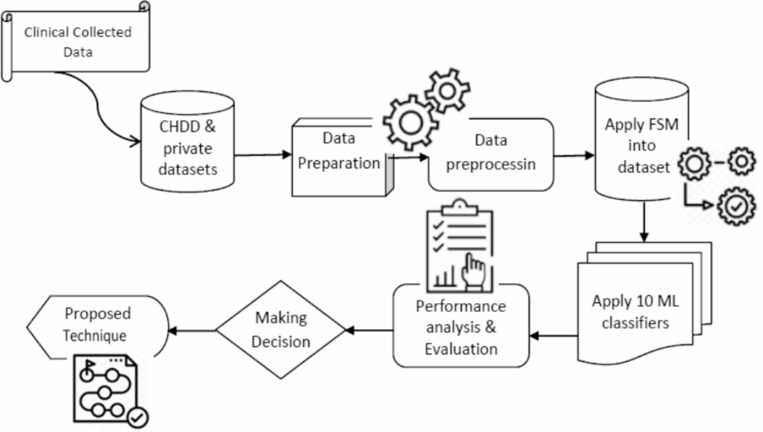
USE CASE DIAGRAM
MACHINE LEARNING FOR REAL – TIME HEART DISEASE PREDICTION

Slide 17
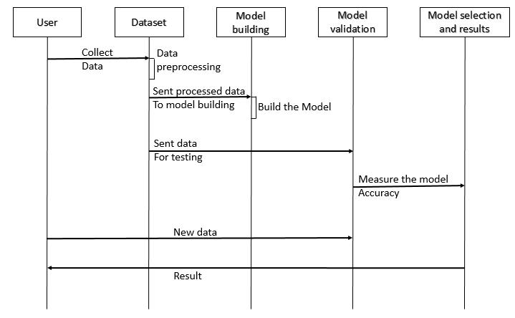
SEQUENCE DIAGRAM
MACHINE LEARNING FOR REAL – TIME HEART DISEASE PREDICTION

Slide 18
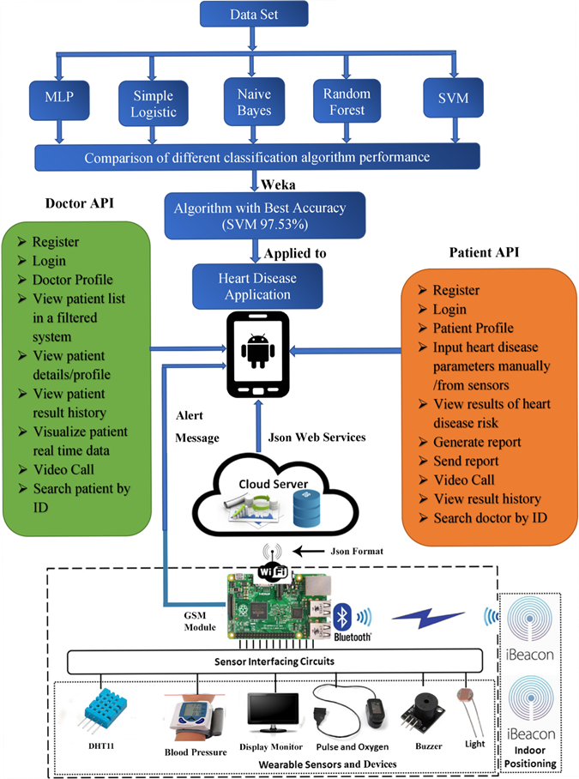
DATA FLOW DIAGRAM
MACHINE LEARNING FOR REAL – TIME HEART DISEASE PREDICTION

Slide 19
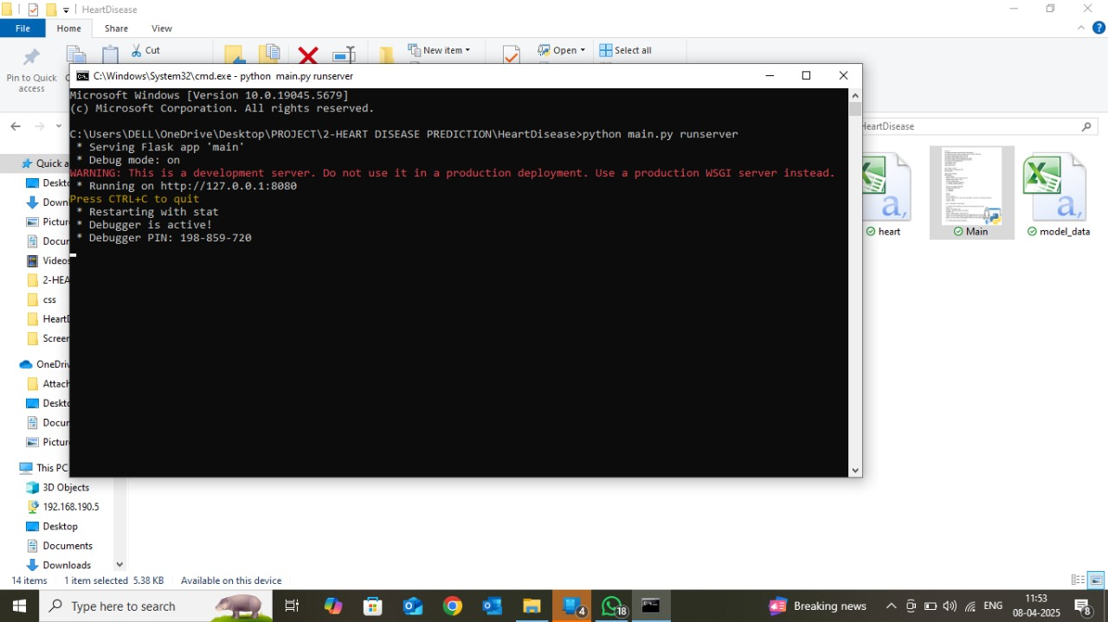
RESULTS
MACHINE LEARNING FOR REAL – TIME HEART DISEASE PREDICTION

Slide 20
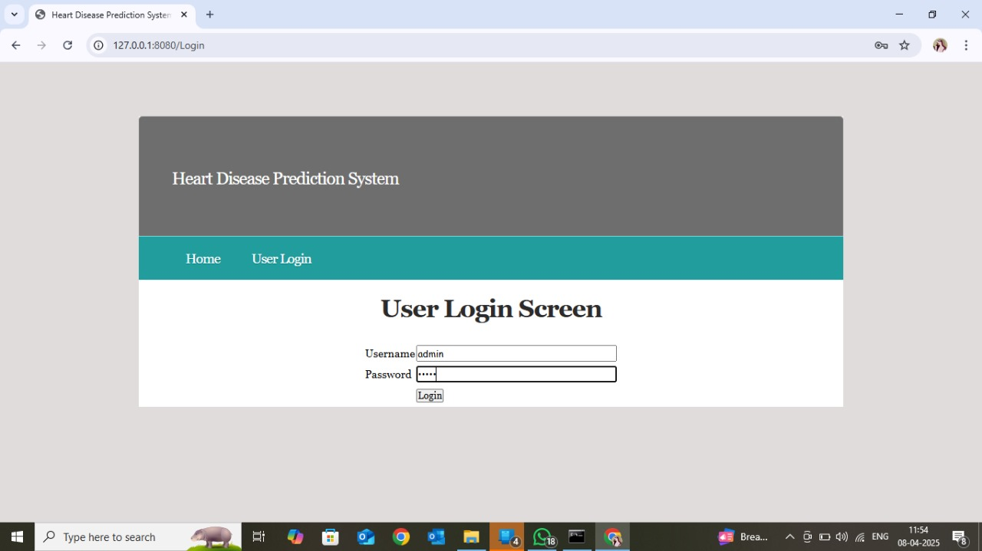
MACHINE LEARNING FOR REAL TIME HEART DISEASE PREDICTION

Slide 21
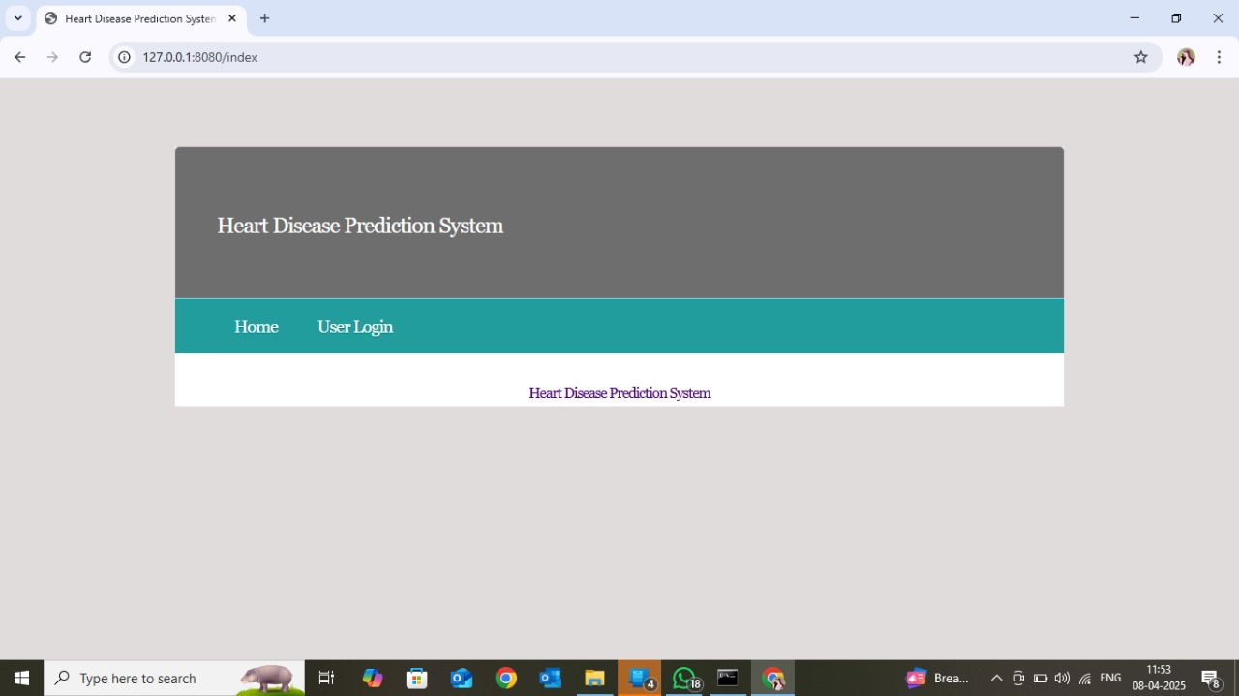
MACHINE LEARNING FOR REAL – TIME HEART DISEASE PREDICTION

Slide 22

MACHINE LEARNING FOR REAL - TIME HEART DISEASE PREDICTION

Slide 23
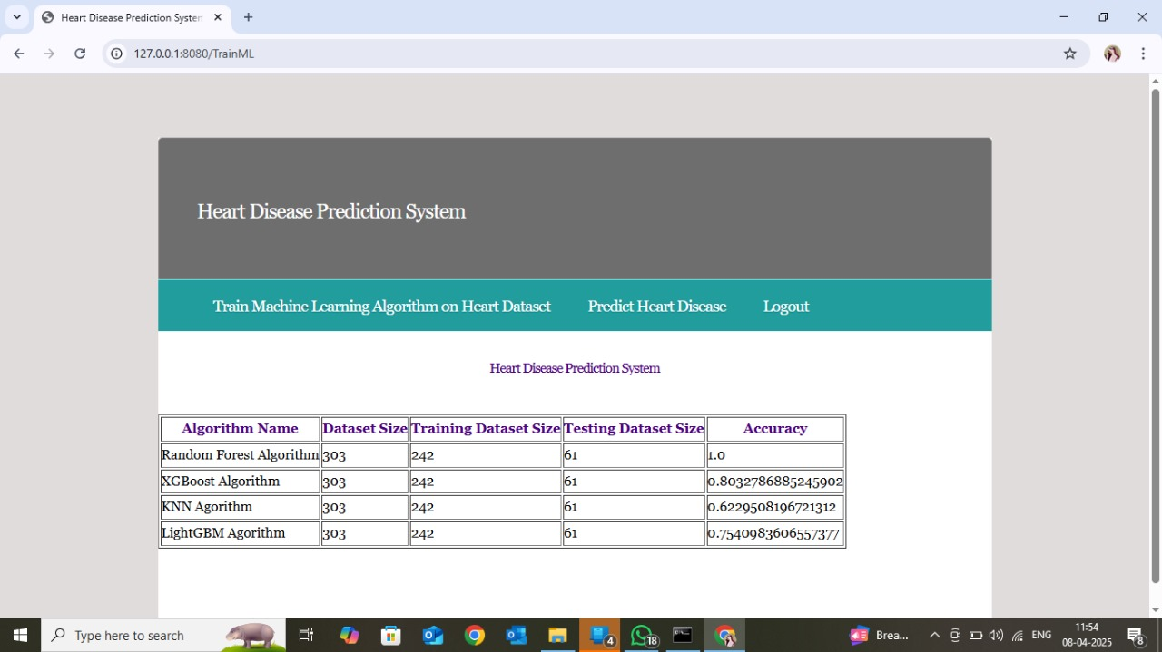
MACHINE LEARNING FOR REAL TIME HEART DISEASE PREDICTION

Slide 24
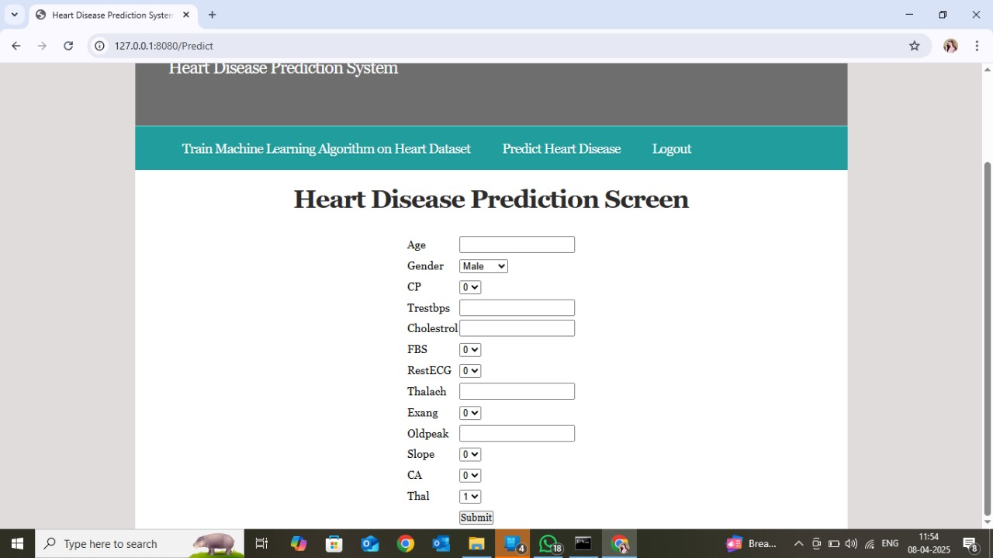

Slide 25
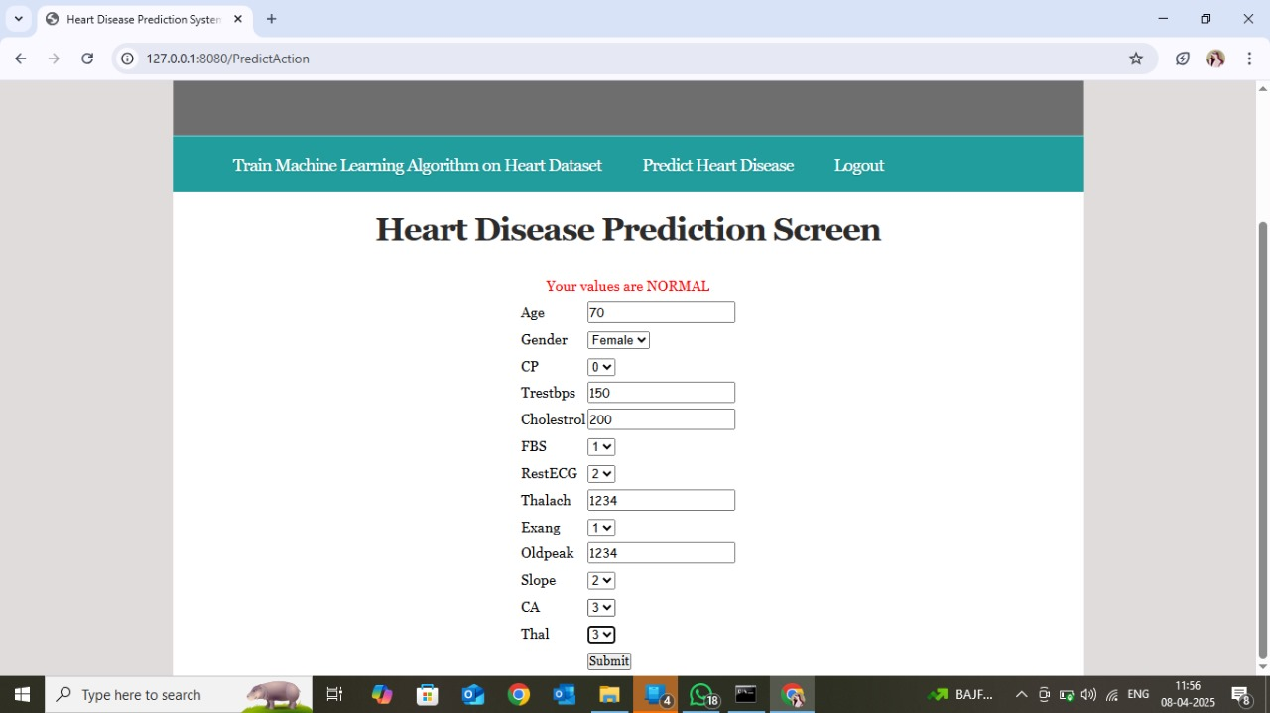

Slide 26
CONCLUSION
The machine learning-based system for real-time heart disease prediction has shown promising results, offering improved accuracy, personalized medicine, and efficient data analysis. This system has the potential to revolutionize heart disease prediction and treatment, enabling healthcare professionals to make informed decisions and provide targeted care to patients, ultimately reducing the risk of heart disease and improving overall health outcomes.
MACHINE LEARNING FOR REAL – TIME HEART DISEASE PREDICTION

Slide 27
FUTURE SCOPE
Future Scope
1. *Integration with Electronic Health Records (EHRs)*: Integrating the system with EHRs to enable seamless data exchange and improve clinical decision-making.
2. *Expansion to Other Diseases*: Expanding the system to predict and diagnose other diseases, such as diabetes, hypertension, and cancer.
3. *Use of Wearable Devices*: Incorporating data from wearable devices to enable real-time monitoring and prediction of heart disease risk.
4. *Development of Mobile App*: Developing a mobile app to enable patients to track their heart disease risk and receive personalized recommendations.
5. *Use of Advanced Machine Learning Techniques*: Exploring the use of advanced machine learning techniques, such as deep learning and transfer learning, to improve the accuracy and efficiency of the system.

Slide 28
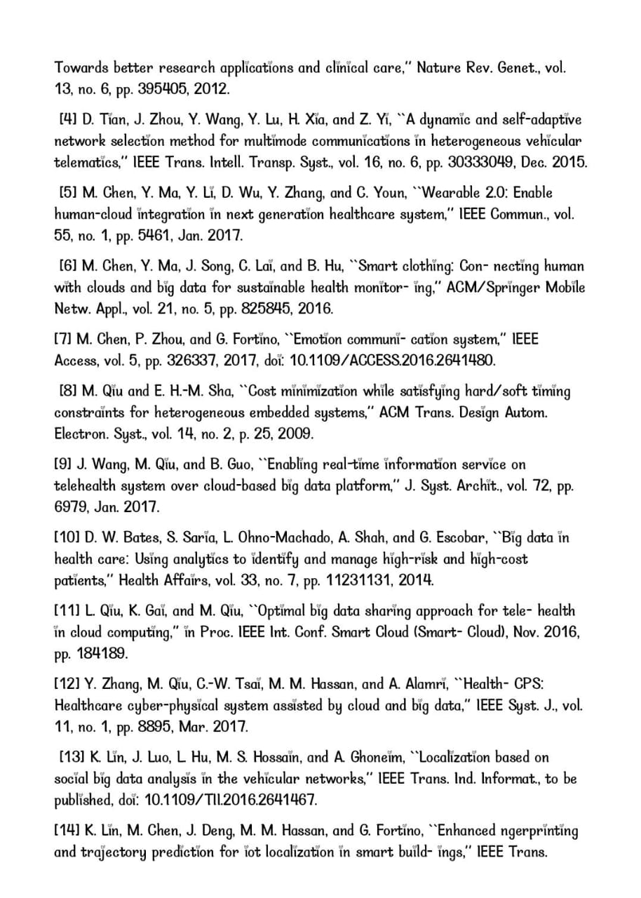
REFERENCES
MACHINE LEARNING FOR REAL – TIME HEART DISEASE PREDICTION

Slide 29
"Predicting heart disease in real-time is not just a technological advancement, it's a lifesaving innovation that can revolutionize the way we approach cardiovascular health."

Slide 30


Slide 31
THANK YOU

